Slide 1

Advanced Bioinformatics for Biotechnology
Bulk RNA EdgeR Project
scRNA Seurat Project
Ceren Akkaya
978311

Slide 2
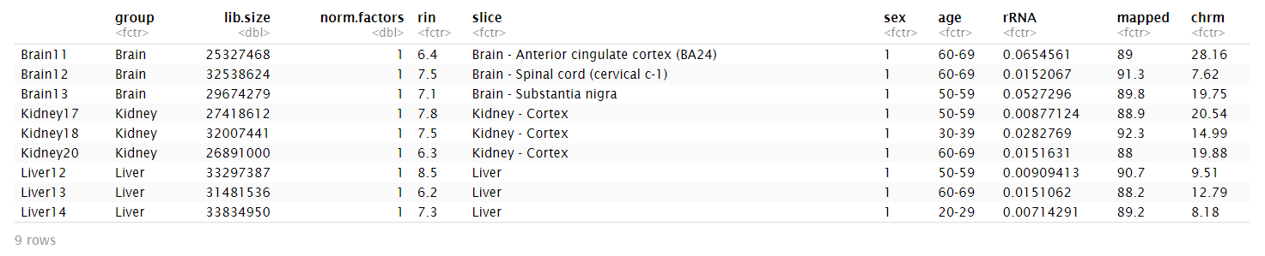
Bulk-RNA Project Quality Control
Main Quality Parameters;
RIN Number > 6
Fraction of rRNA < 10%
Percantage of Uniquely Mapped Reads > 85%
Other QC Parameters;
Age
Sex
Slice of the organ
ChrM

Slide 3
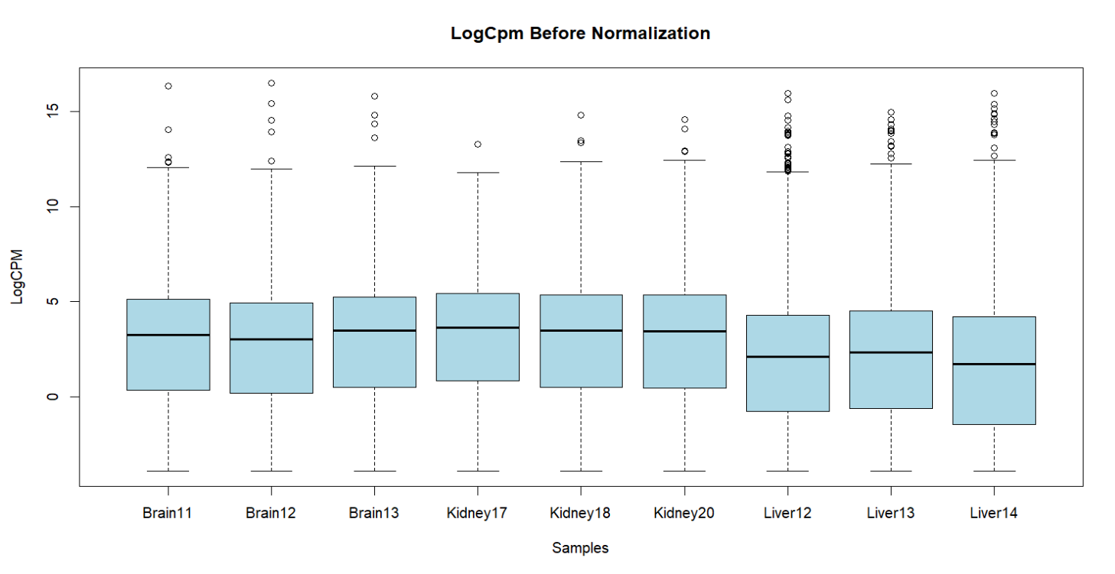
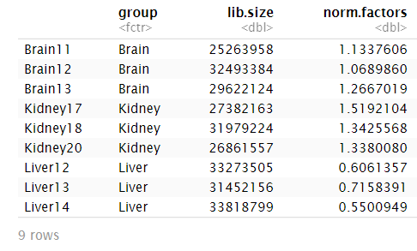
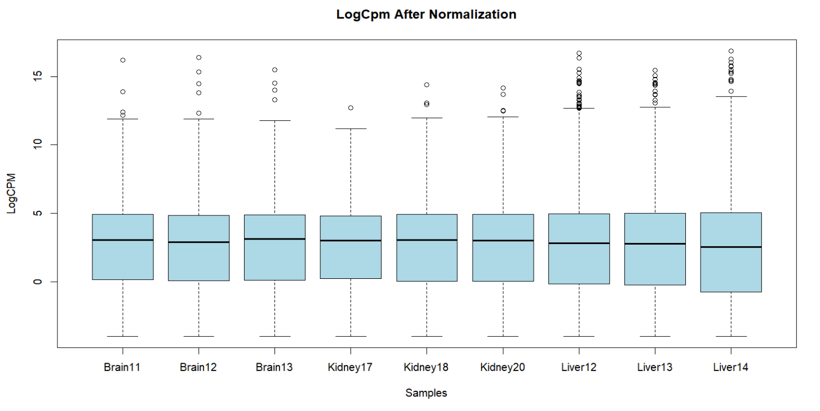
Normalization
Before Normalization: This is just the distribution of original count divided by library size and transformed into cpm. The line of boxplot shows the median of each replicate’s expression.
After Normalization: Median of all replicates become in more less equal value. Outliers didn’t change. The change is happens in the middle of boxplot.
METHOD IS TMM NORMALIZATION

Slide 4
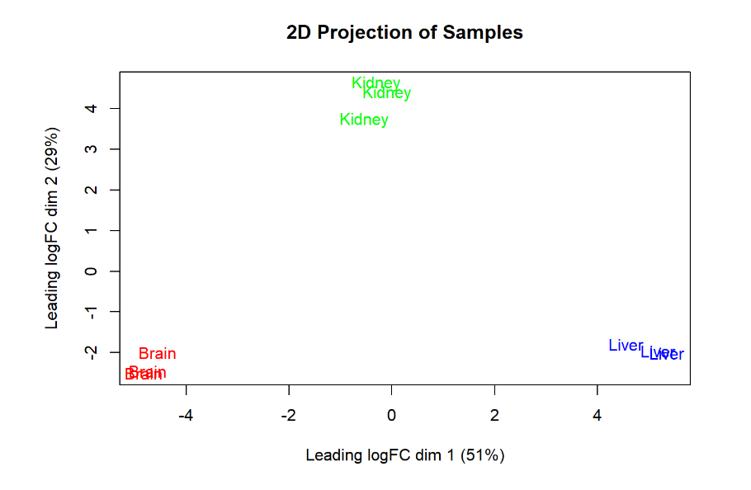
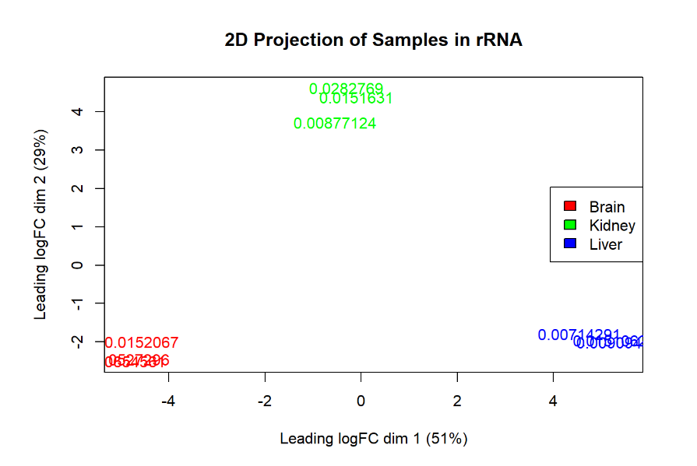
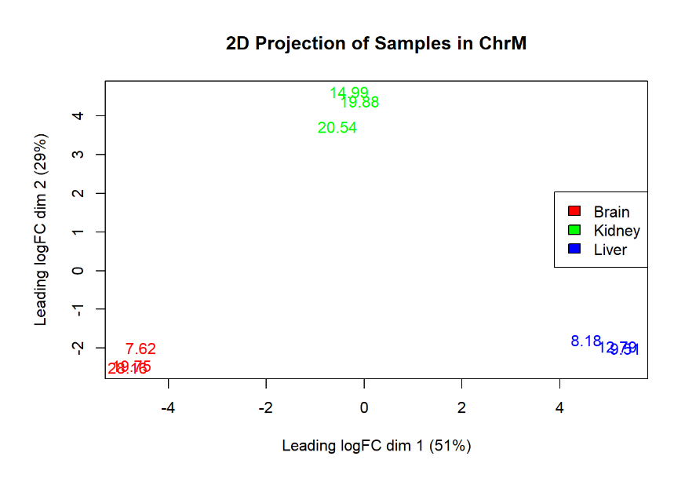
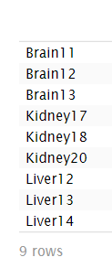
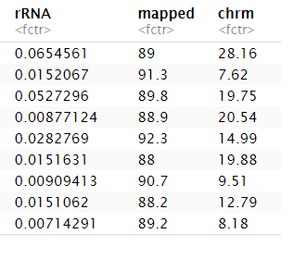
Two Dimensional Projection

Slide 5
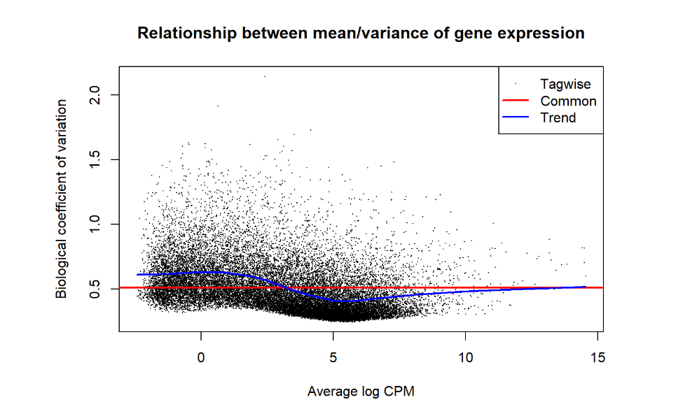
BCV PLOT
Estimate Dispersion: This plot explains the relationship between the average expression and the variability. Underline statistical model is NB distribution.

Slide 6
DE Genes
Number Of Genes | -1*Brain vs 1*Kidney | -1*Brain vs 1*Liver | -1*Kidney vs 1*Liver
Down Regulated | 1697 | 3438 | 1434
Not Significant | 20147 | 17363 | 21011
Up Regulated | 1652 | 2695 | 1051
One tissue type according to others | Brain_Both | Kidney_Both | Liver_Both
Number of DE Genes | 1144 Top Gene is PMP2 | 399 Top Gene is HNF1B | 727 Top Gene is KNG1
Results are filtered with:
Genes who starts with; LOC, LINC, MIR, SNORD, RPL
logCPM > 0 FDR < 0.01
logCPM > 0 because when it is negative it means they are in very low expression they don’t have any meaning.

Slide 7
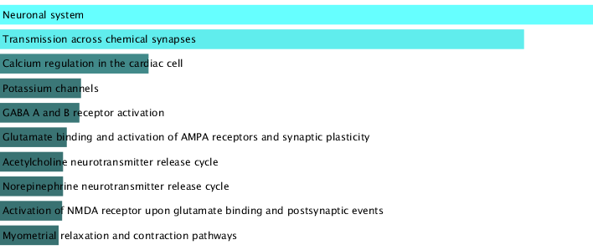
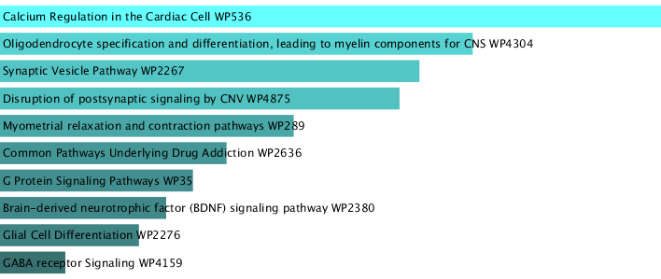
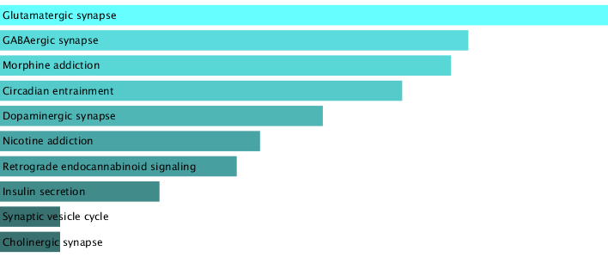
Functional Enrichment Analysis, Brain
Pathways, WikiPathway 2021
Pathways, Bioplanet 2019
Pathways, KEGG 2021

Slide 8
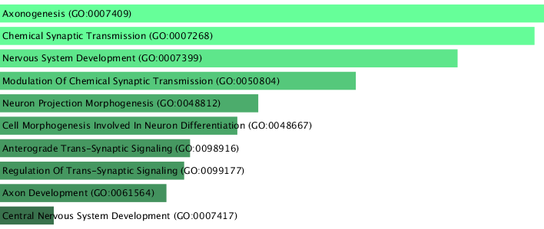
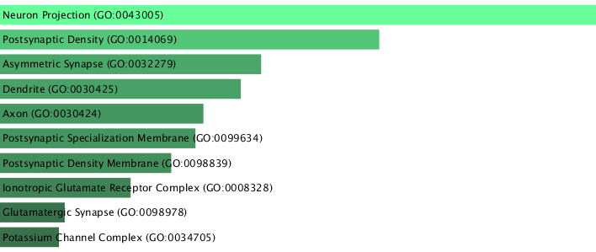
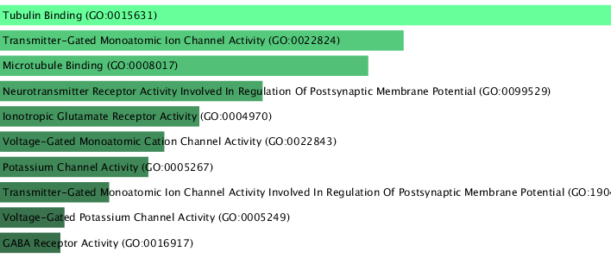
Functional Enrichment Analysis, Brain
GO_Biological Process 2023
GO_Cellular Component 2023
GO_Molecular Function 2023

Slide 9
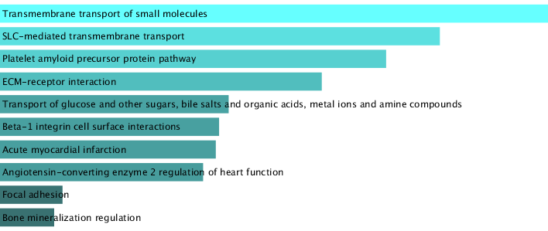
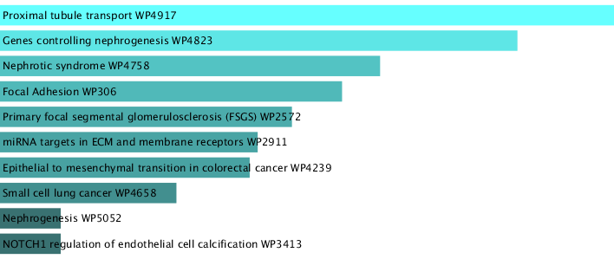
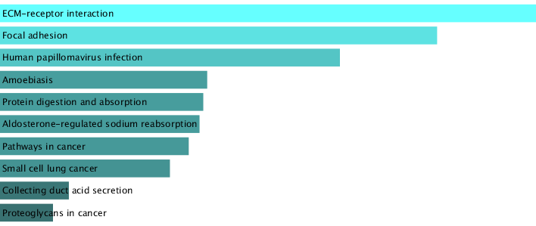
Functional Enrichment Analysis, Kidney
Pathways, Bioplanet 2019
Pathways, WikiPathway 2021
Pathways, KEGG 2021

Slide 10
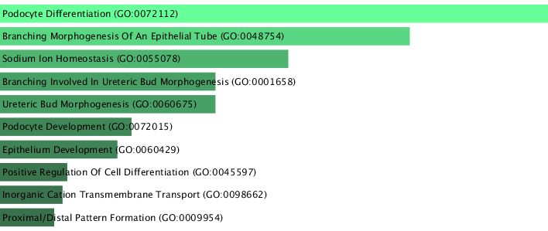
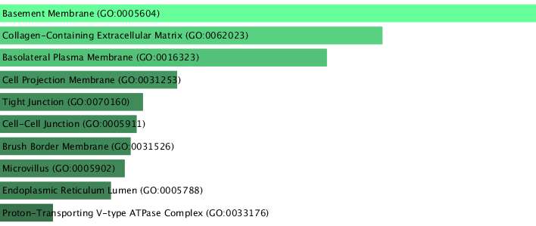
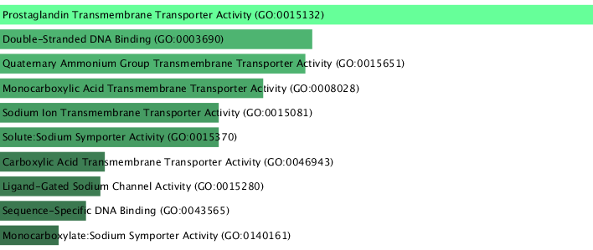
Functional Enrichment Analysis, Kidney
GO_Biological Process 2023
GO_Cellular Component 2023
GO_Molecular Function 2023

Slide 11
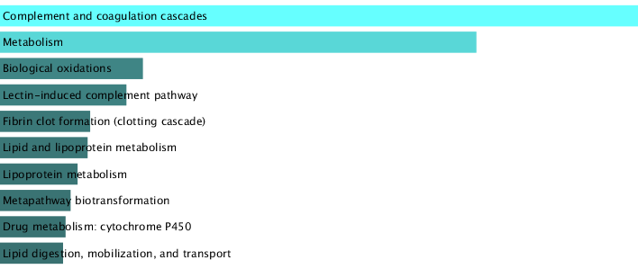
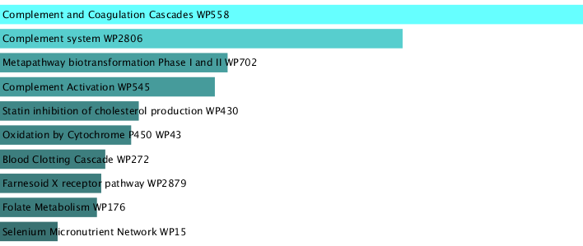
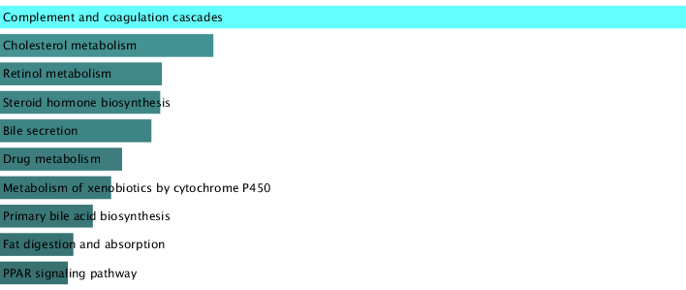
Functional Enrichment Analysis, Liver
Pathways, WikiPathway 2021
Pathways, Bioplanet 2019
Pathways, KEGG 2021

Slide 12
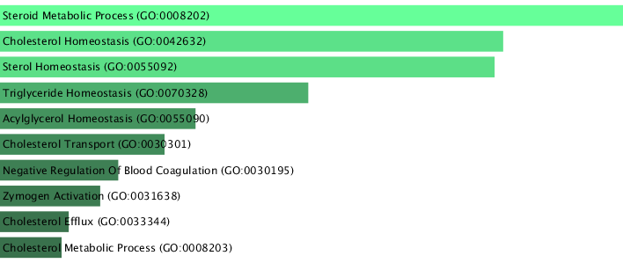
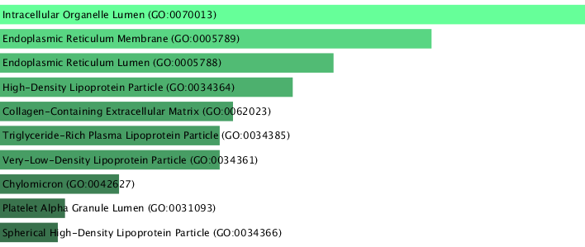
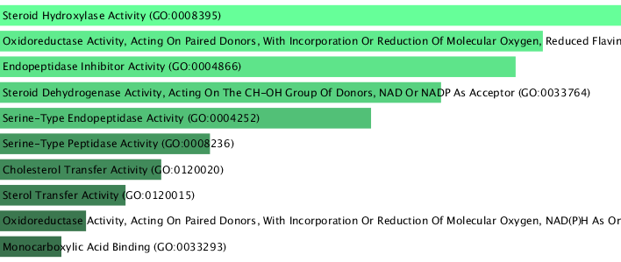
Functional Enrichment Analysis, Liver
GO_Biological Process 2023
GO_Cellular Component 2023
GO_Molecular Function 2023

Slide 13
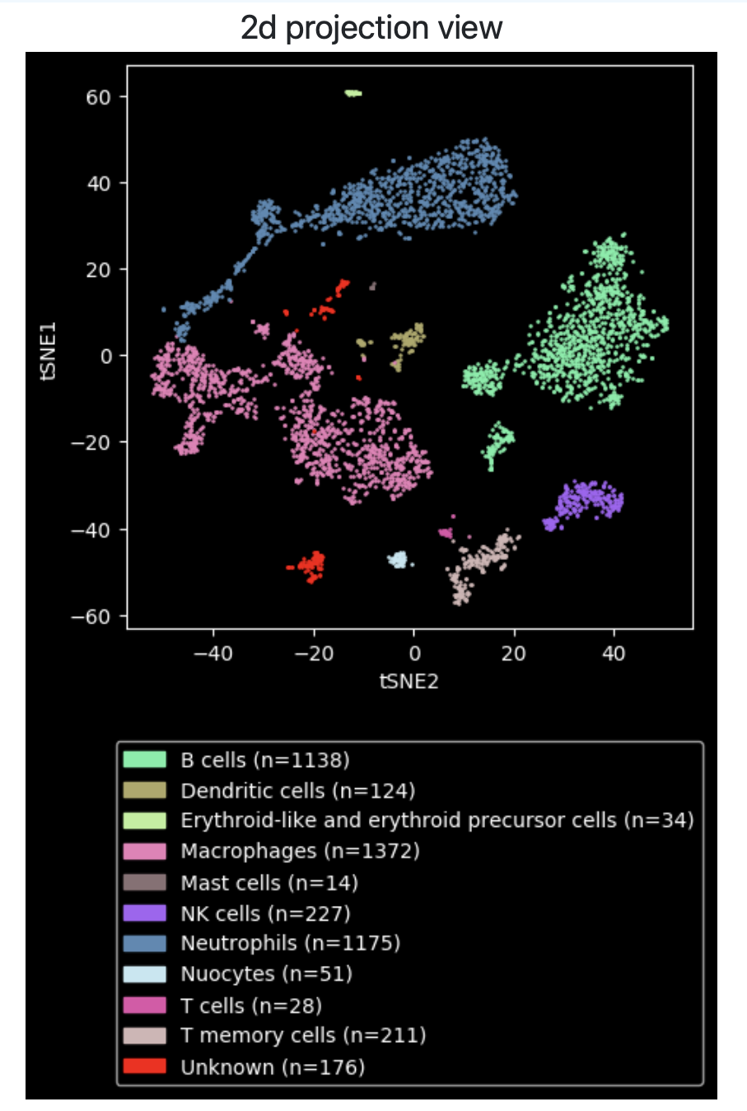
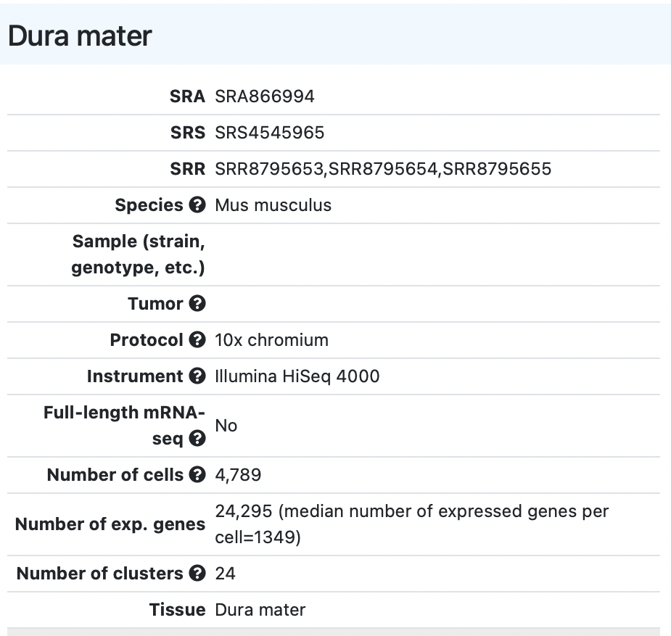
scRNA Seurat Project

Slide 14
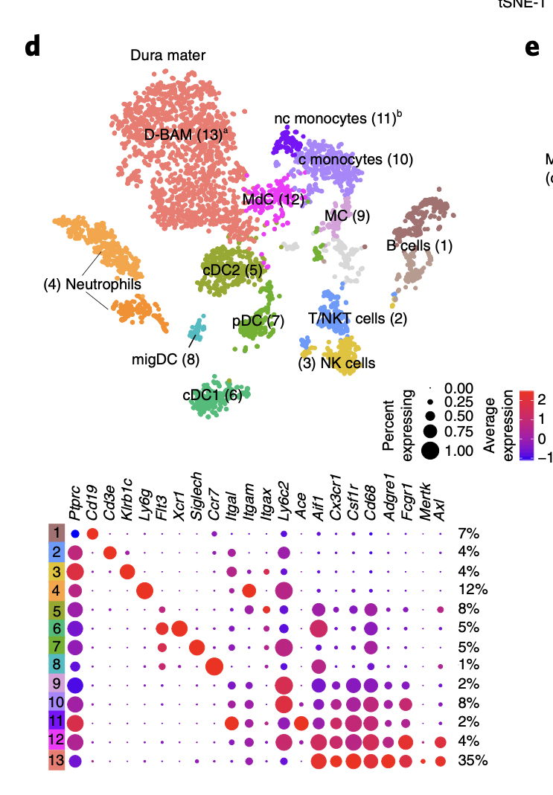
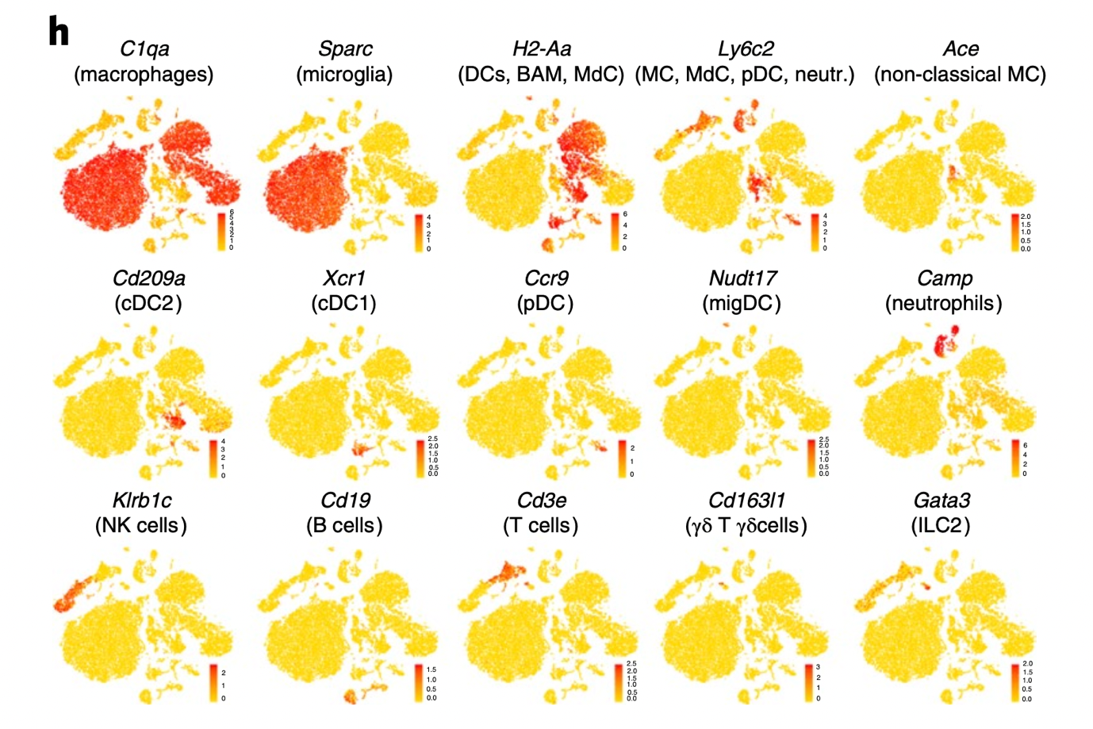
A single-cell atlas of mouse brain macrophages reveals unique transcriptional identities shaped by ontogeny and tissue environment.
Van Hove, H., Martens, L., Scheyltjens, I. et al. A single-cell atlas of mouse brain macrophages reveals unique transcriptional identities shaped by ontogeny and tissue environment. Nat Neurosci 22, 1021–1035 (2019). https://doi.org/10.1038/s41593-019-0393-4

Slide 15
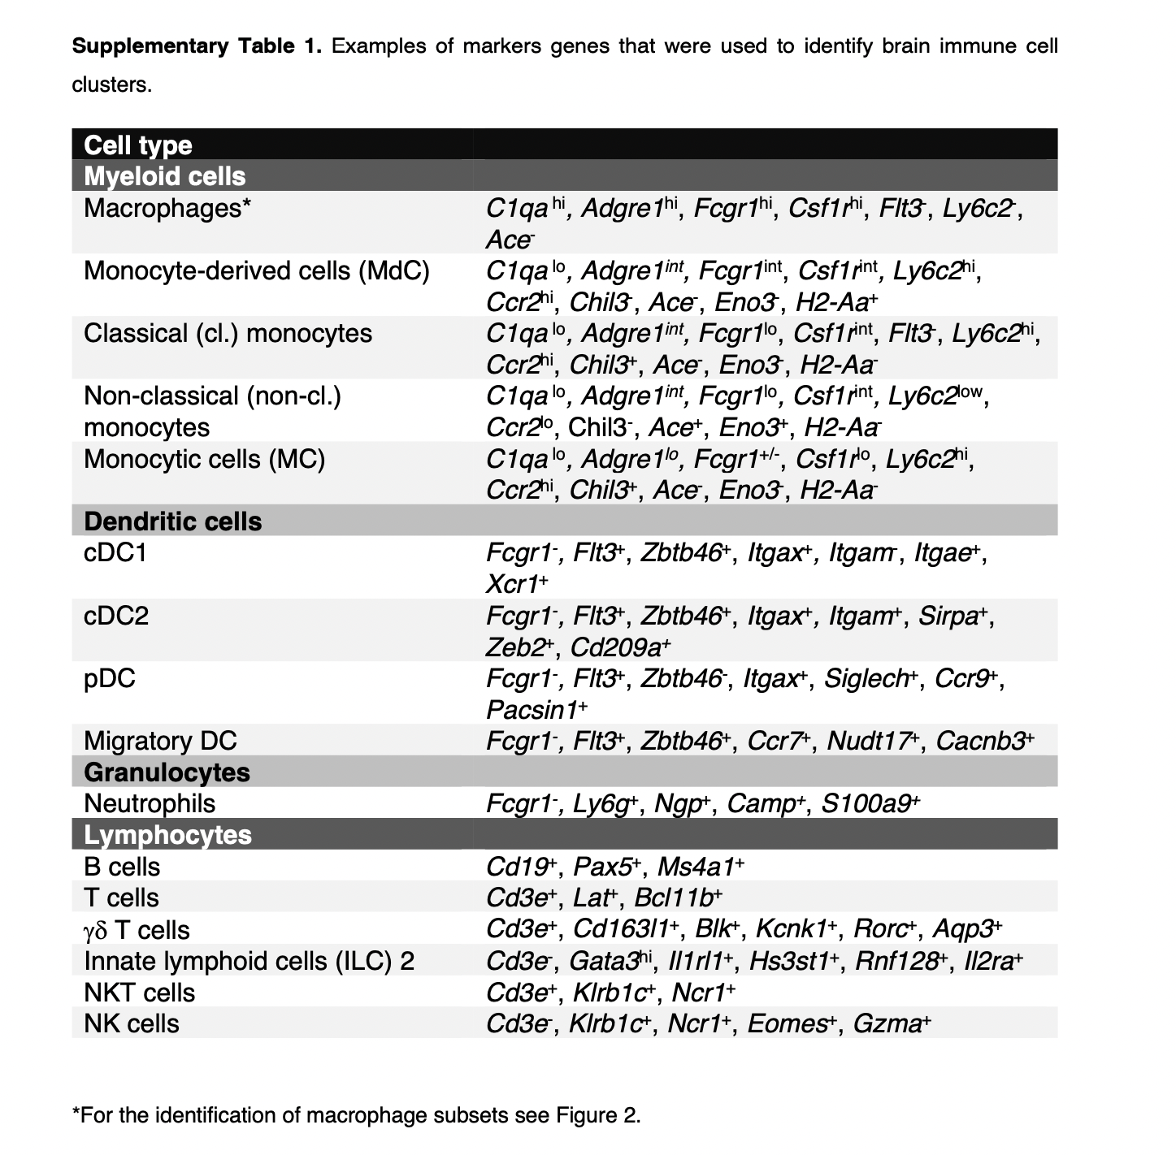
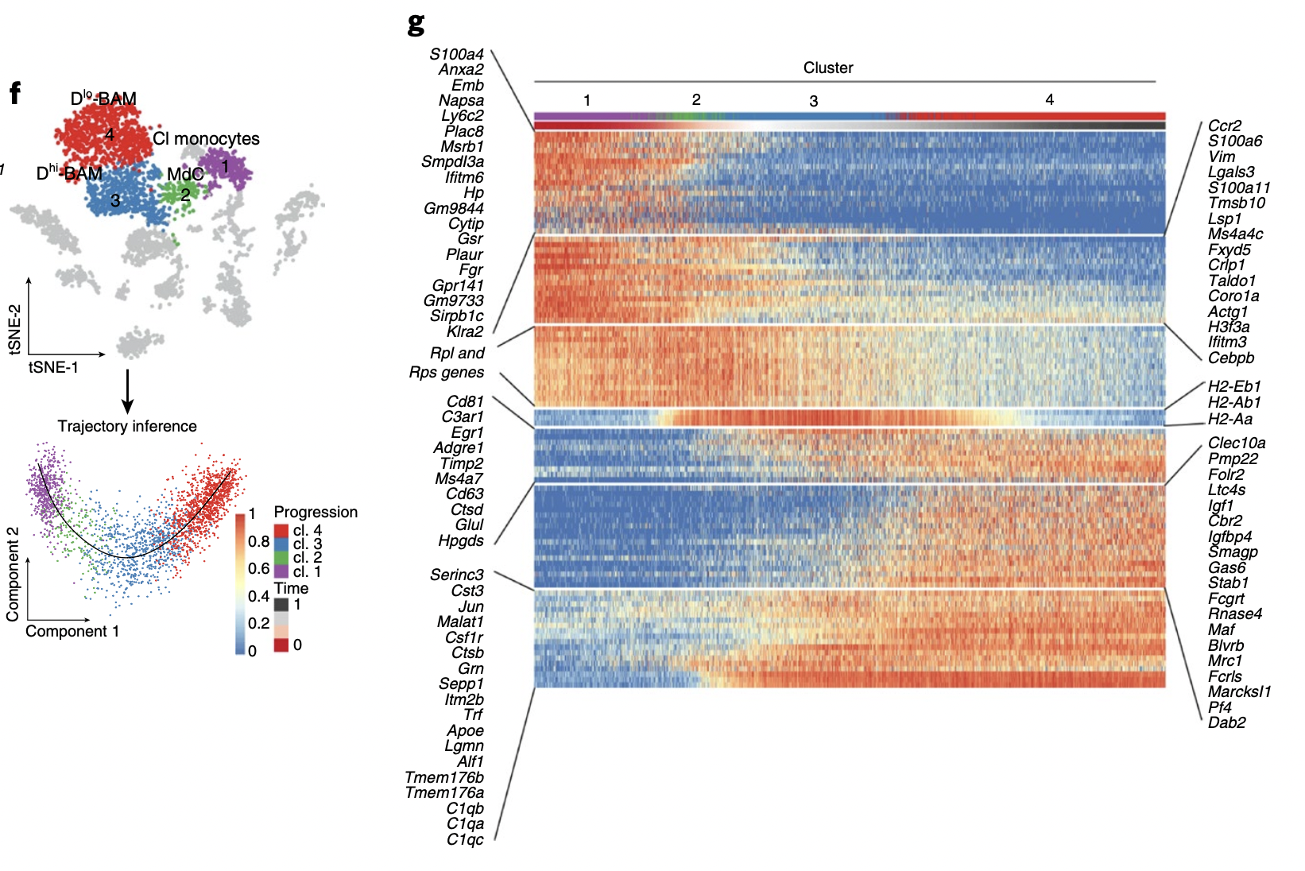
Marker Genes from Publication
Genes expressed in Macrophages and Monocytes

Slide 16
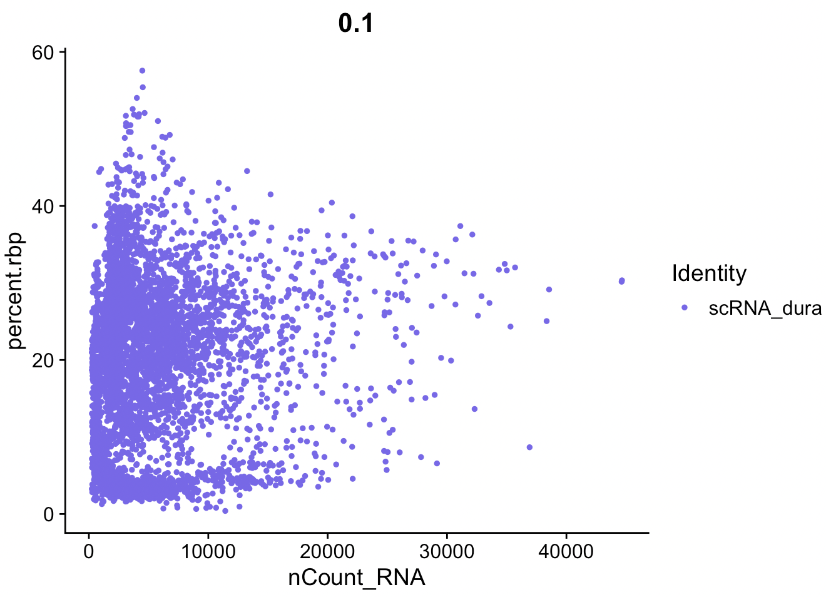
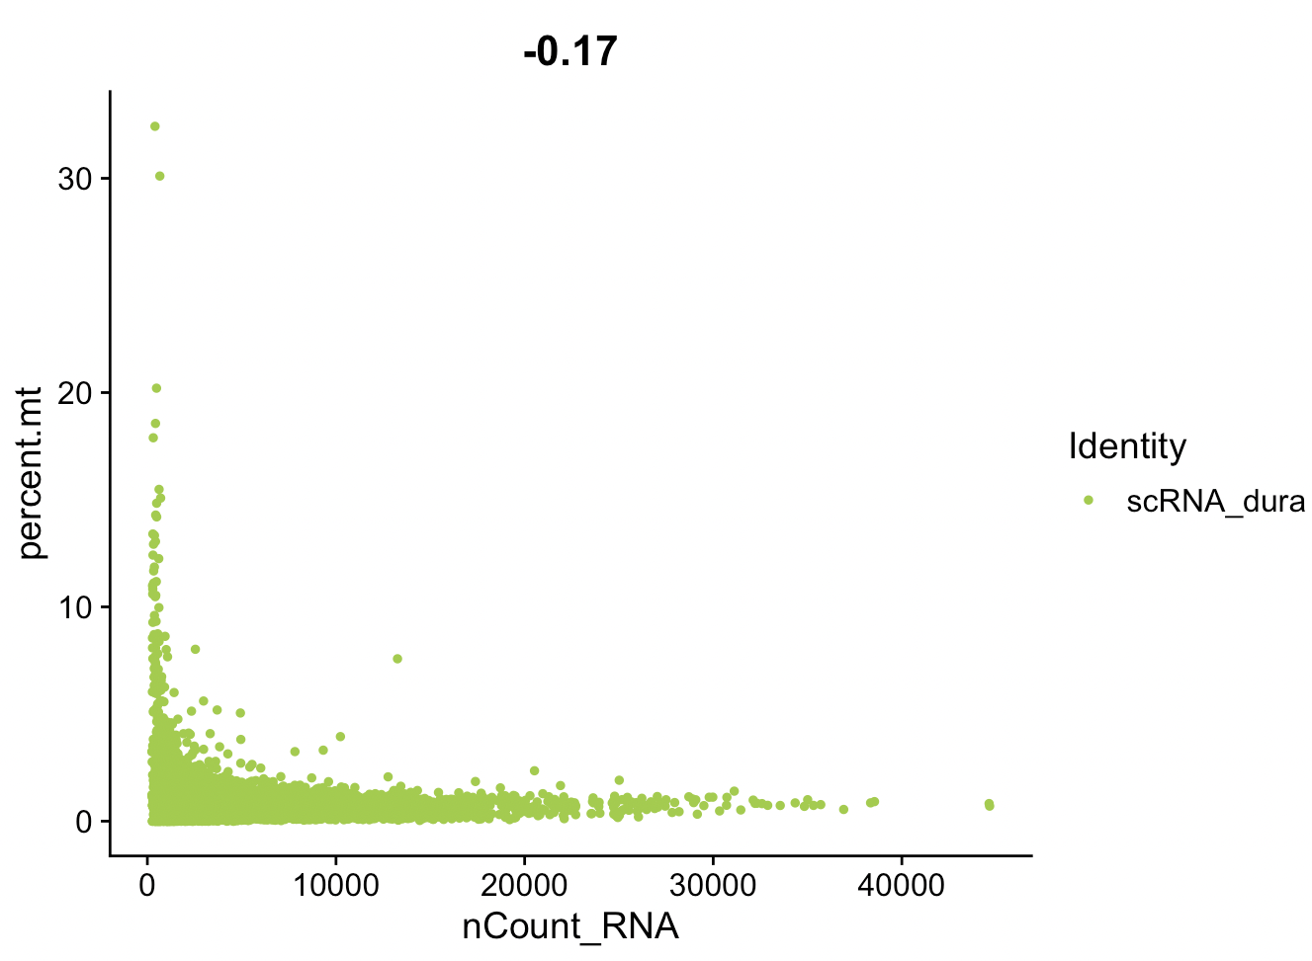
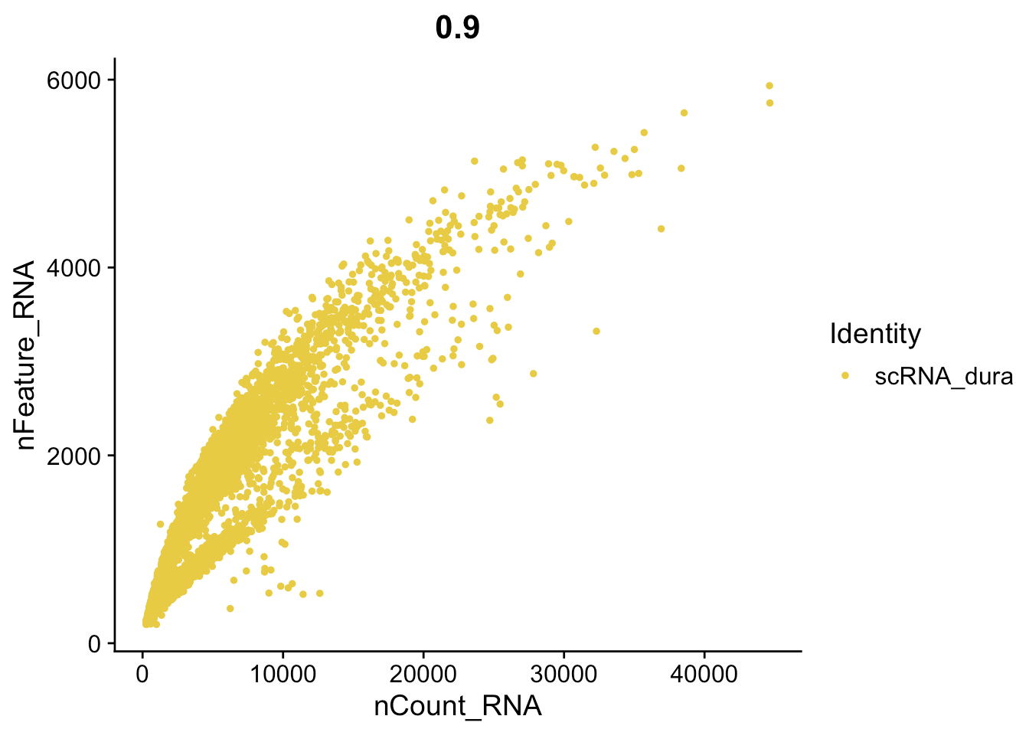
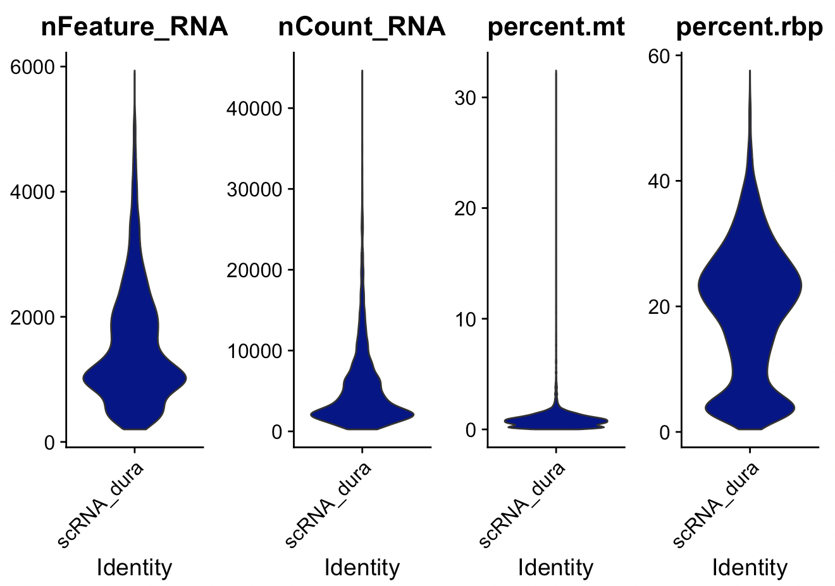
Cell Quality Control
Filtering Parameters that I set:
NFeature_RNA > 200 and nFeature_RNA < 4000
Percantage of mtRNA < 5
Before filtering:
There are 5217 cells
After filtering:
5007 cells remain.

Slide 17
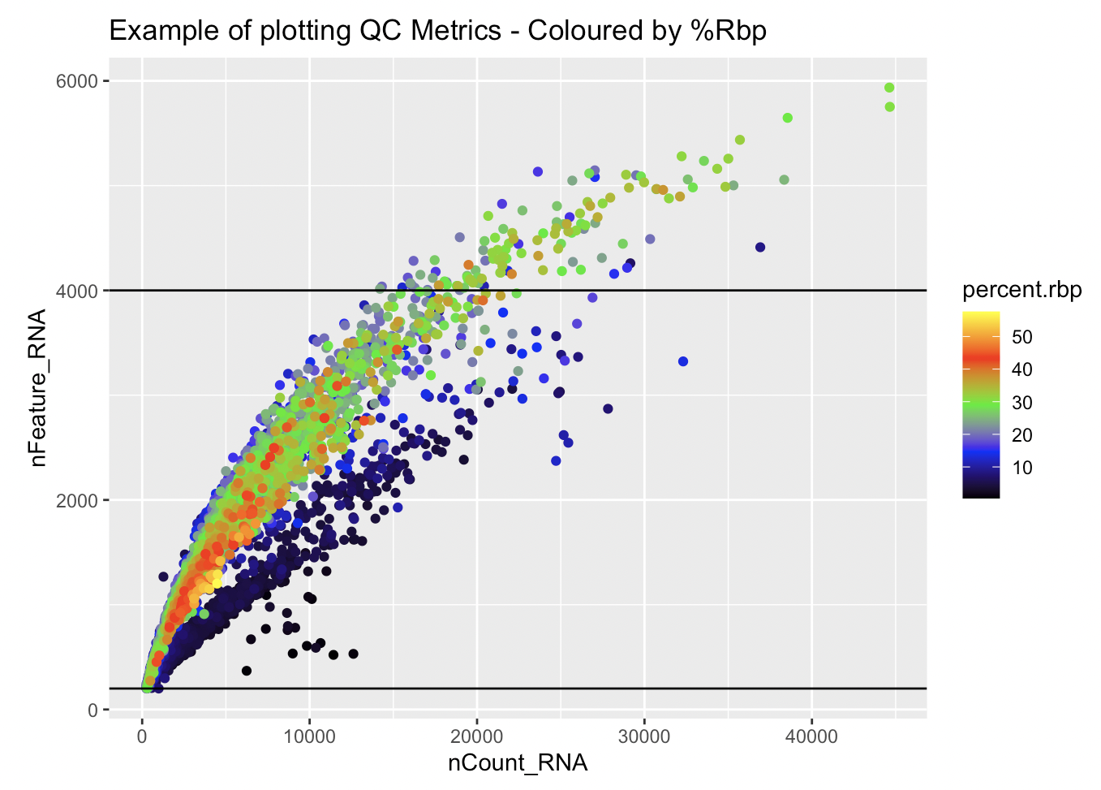
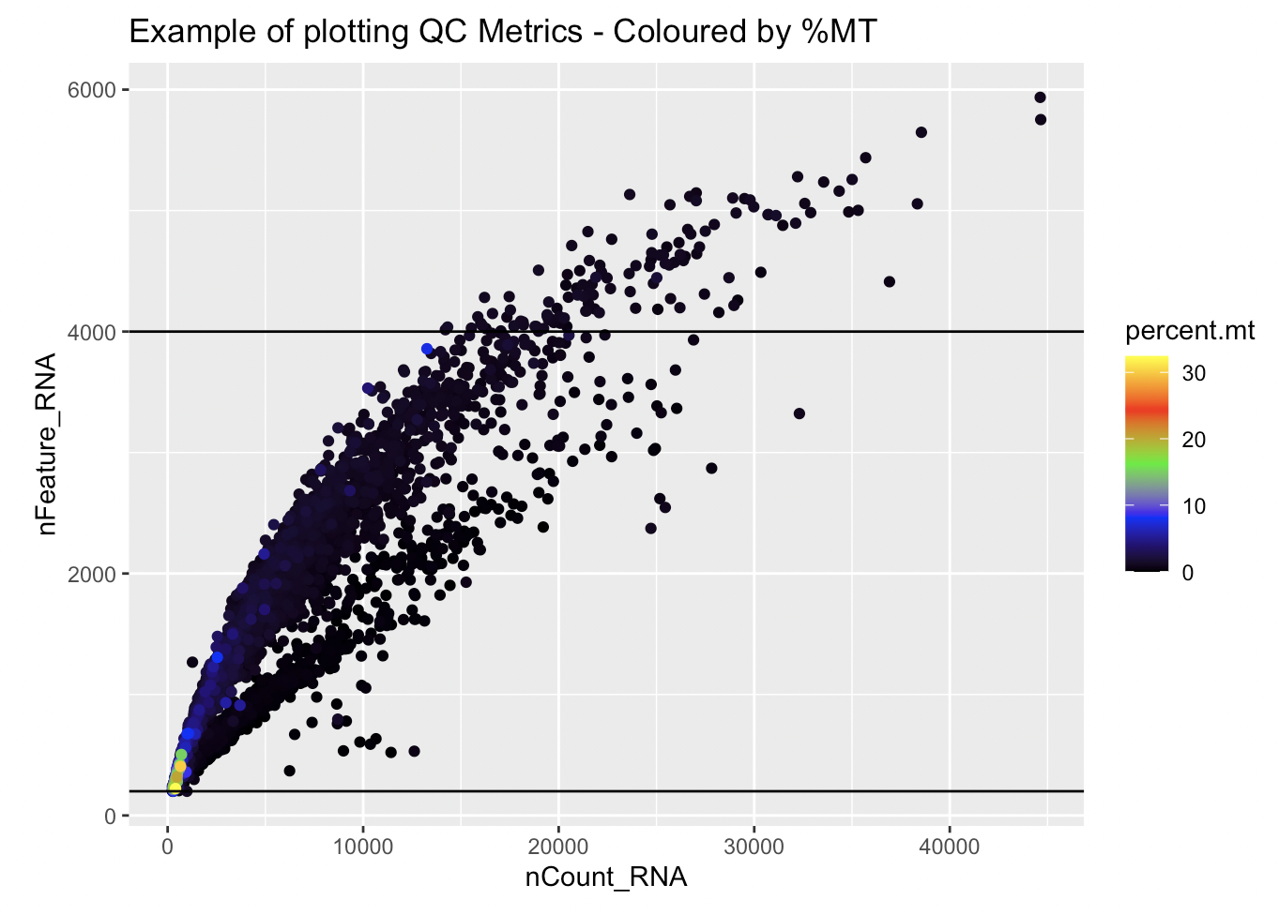

Slide 18
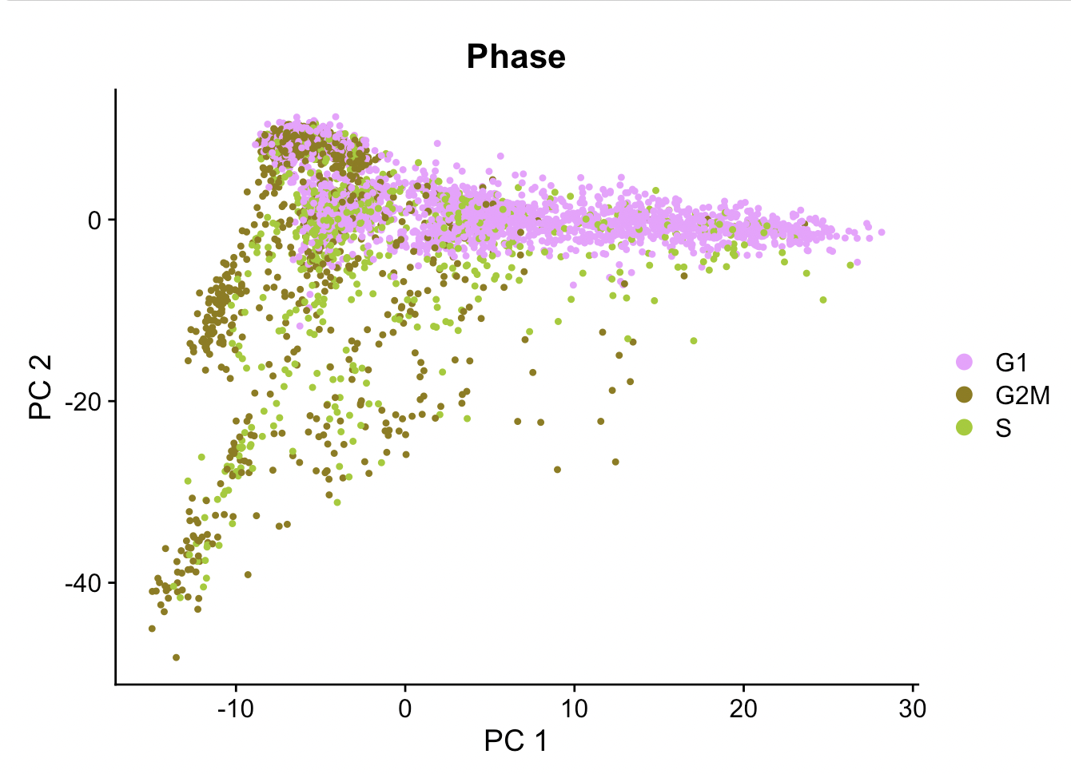
Cell cycle phase

Slide 19
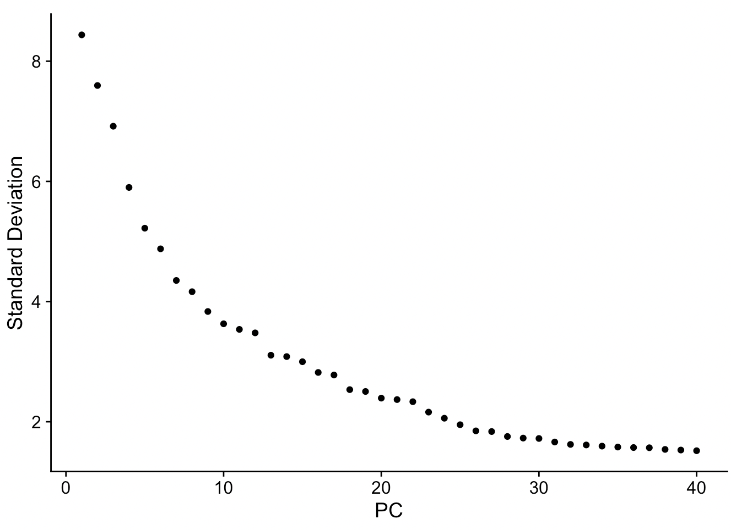
Elbow Plot and First 5 PC
PC_ 1 Positive: Csf1r, C1qa, C1qb, C1qc, Aif1 Negative: Cd24a, Wfdc21, Pglyrp1, Lcn2, Hmgb2
PC_ 2 Positive: Retnlg, Mmp9, Mmp8, Slpi, Pglyrp1 Negative: Stmn1, Pclaf, Top2a, Rrm2, Ccna2
PC_ 3 Positive: Ly6d, Ighm, Cd79a, Cd79b, Iglc3 Negative: Hp, Lcn2, Ifitm6, Anxa1, Wfdc21
PC_ 4 Positive: Cd79b, Cd79a, Ly6d, Ebf1, Ighm Negative: Nkg7, Ms4a4b, Ctsw, Ccl5, Il2rb
PC_ 5 Positive: Gas6, Pf4, Cbr2, Igf1, Ltc4s Negative: S100a4, Ccr2, Lgals3, Ms4a4c, Crip1

Slide 20
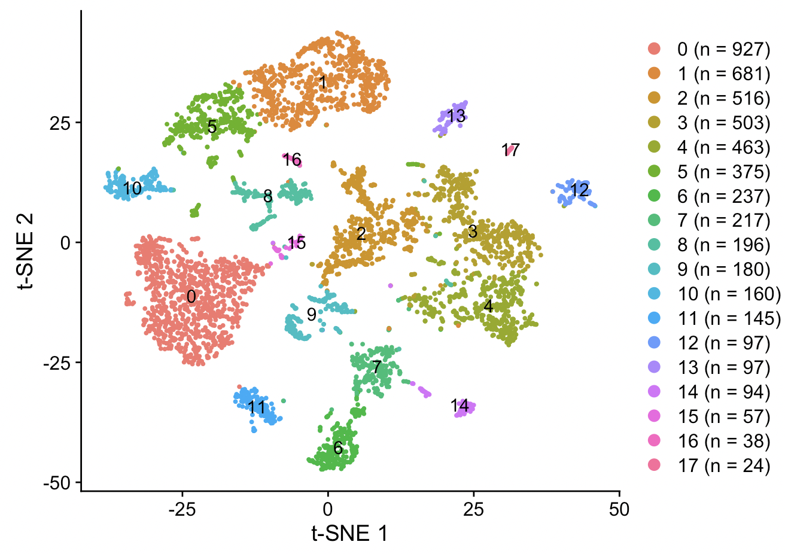
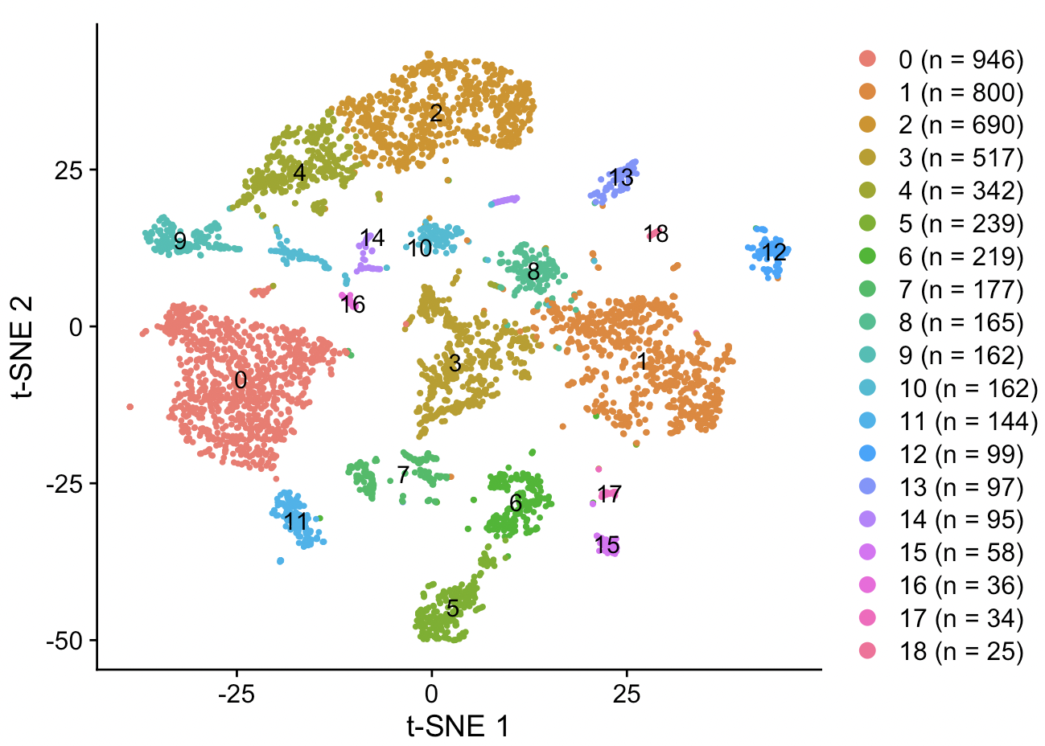
Different PCA and Resolution Settings
PCA: 26, Resolution: 0.3
PCA:36, Resolution: 0.5

Slide 21
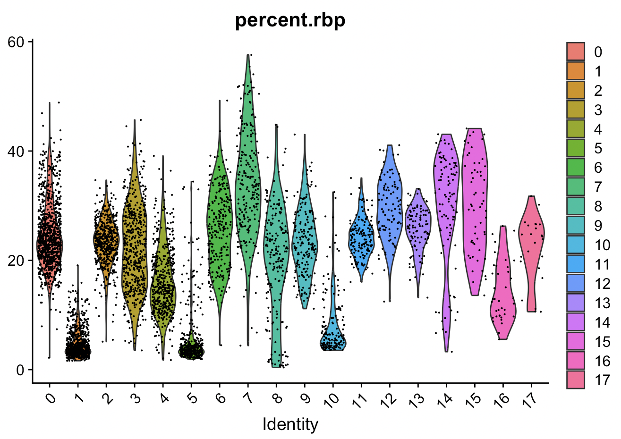
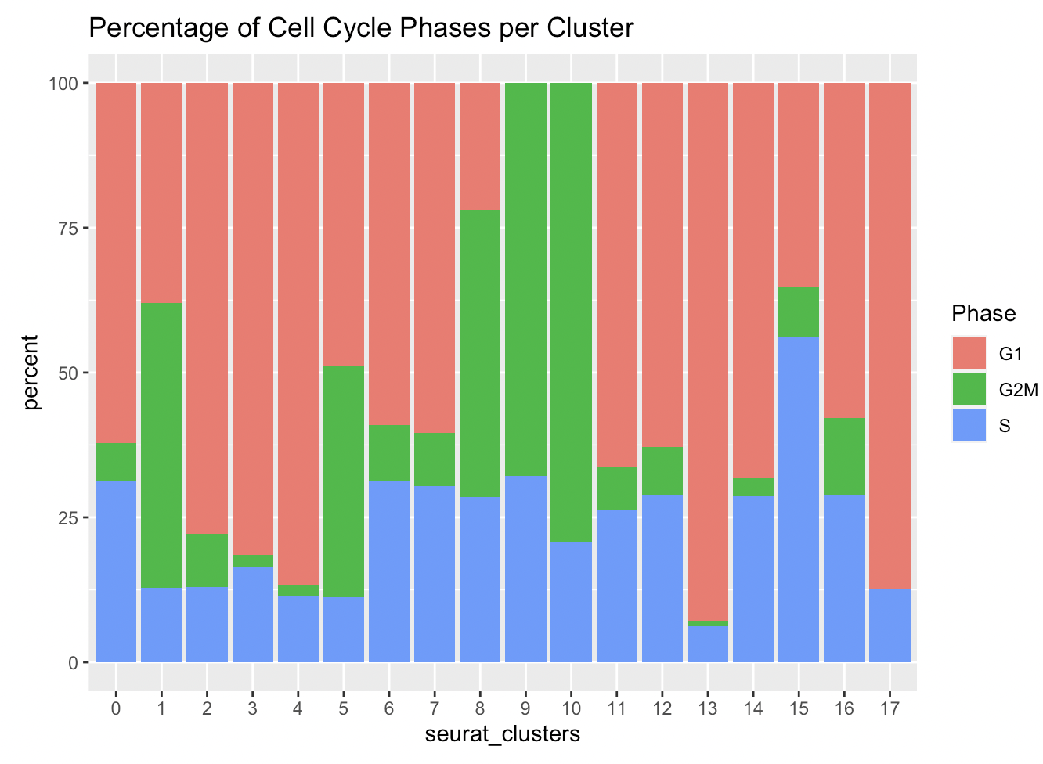
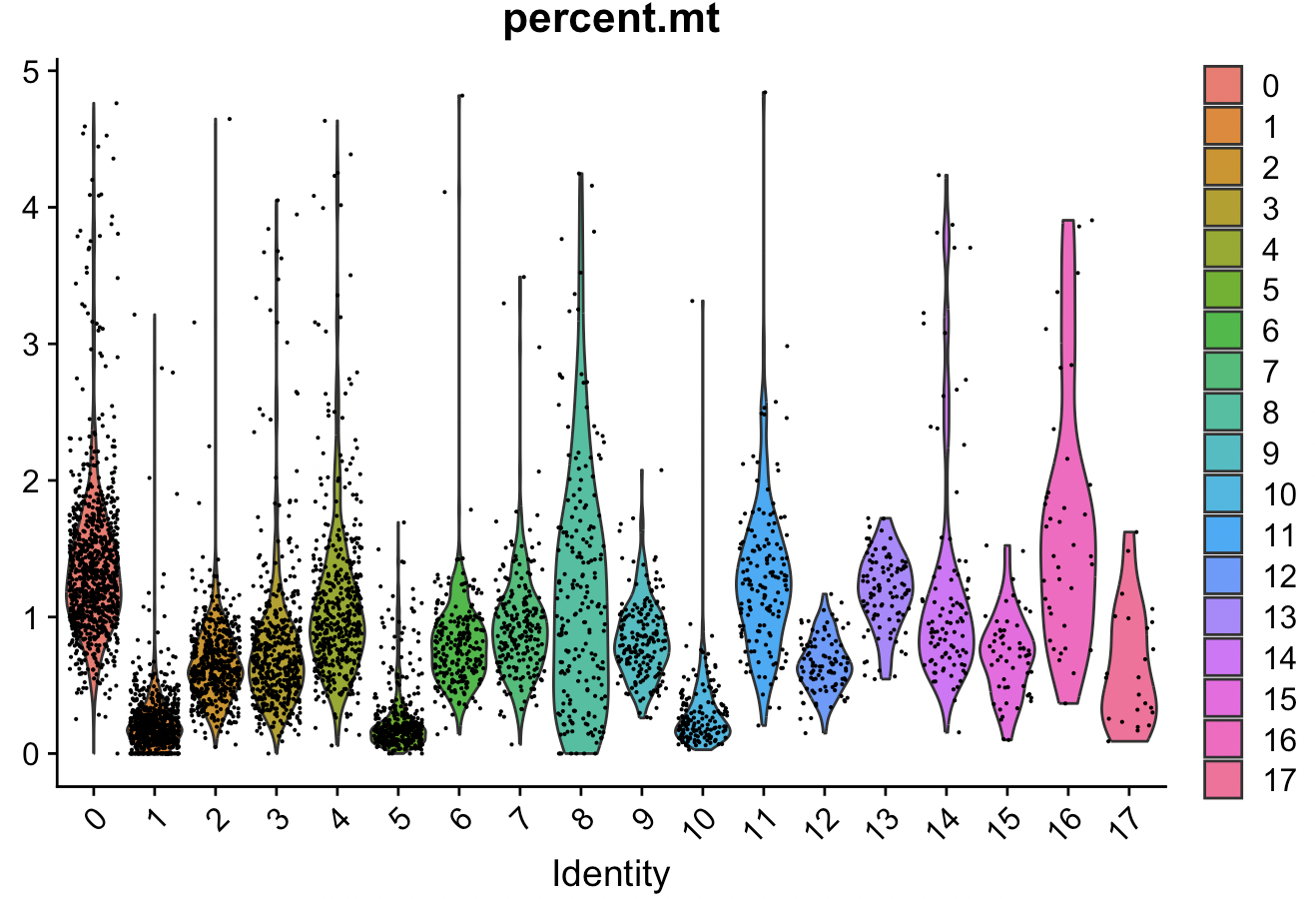

Slide 22
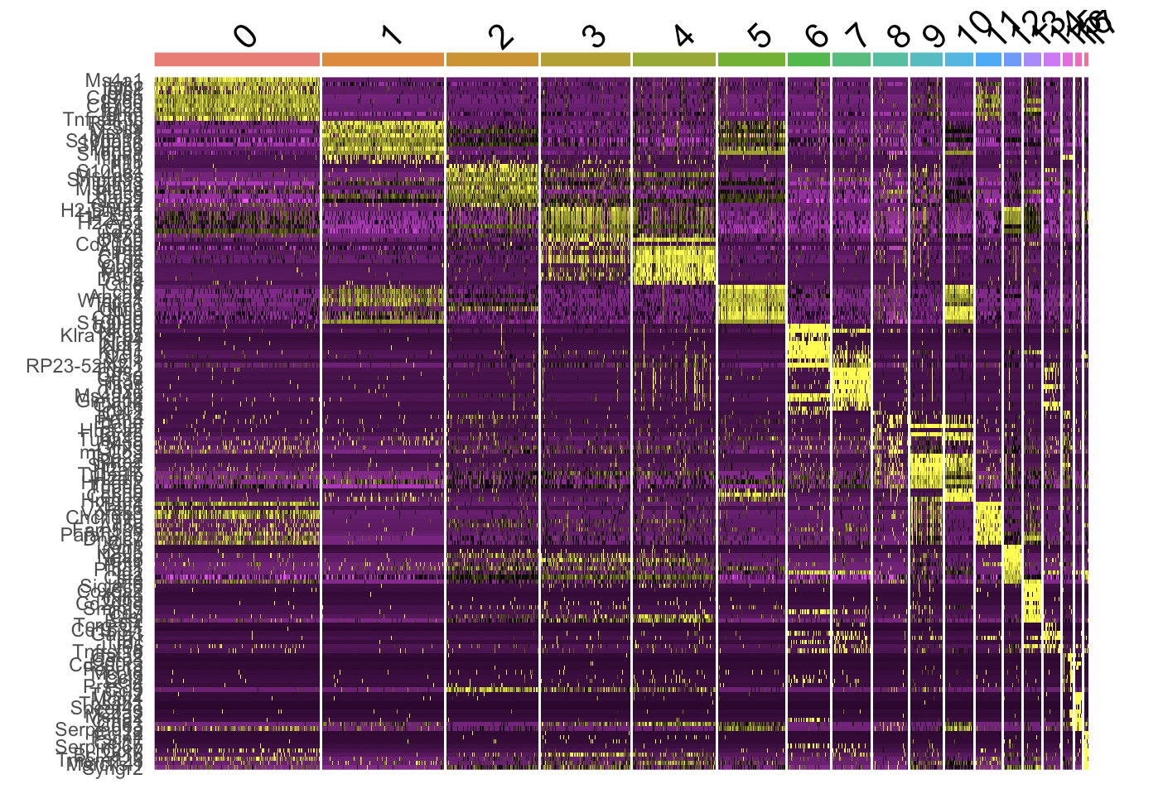
Heatmap

Slide 23
